Slide 1
Arithmetic/logic unit (alu)

Slide 2
alu
All arithmetic operation take place in the arithmetic/logic unit of a computer. The main purpose is to accept binary data that are stored in the memory and to execute arithmetic and logic operations on these data according to instructions from the control unit.
It has at least two FF registers. B register and accumulator (A) register.

Slide 3
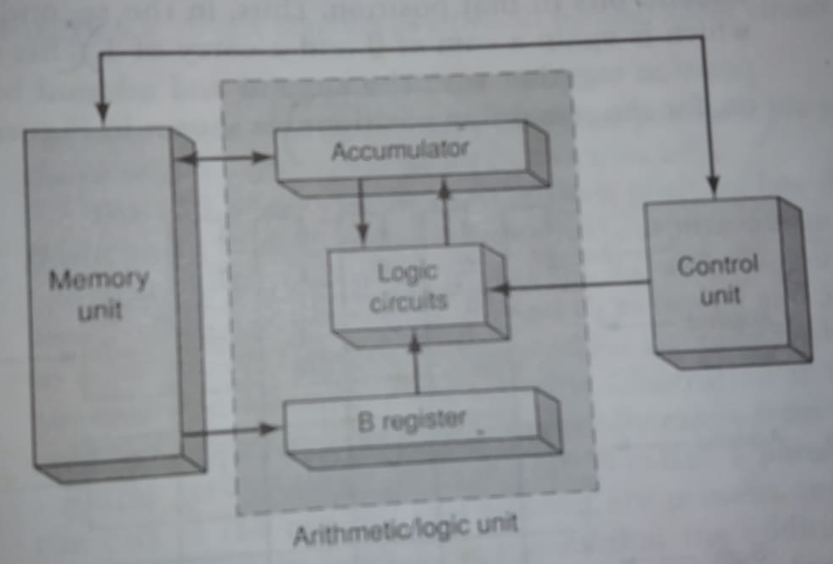
Alu

Slide 4
outline
Adder circuits, Half adder (HA), Full adder (FA), Carry propagation, Parallel adder, carry look-ahead adder, The BCD adder circuit, Cascading BCD adder, Binary multiplier.
Counter and registers: : Asynchronous counter: Ripple counters, Counters with mod numbers <2^{n}, IC asynchronous counters.

Slide 5
Parallel binary adder

Slide 6
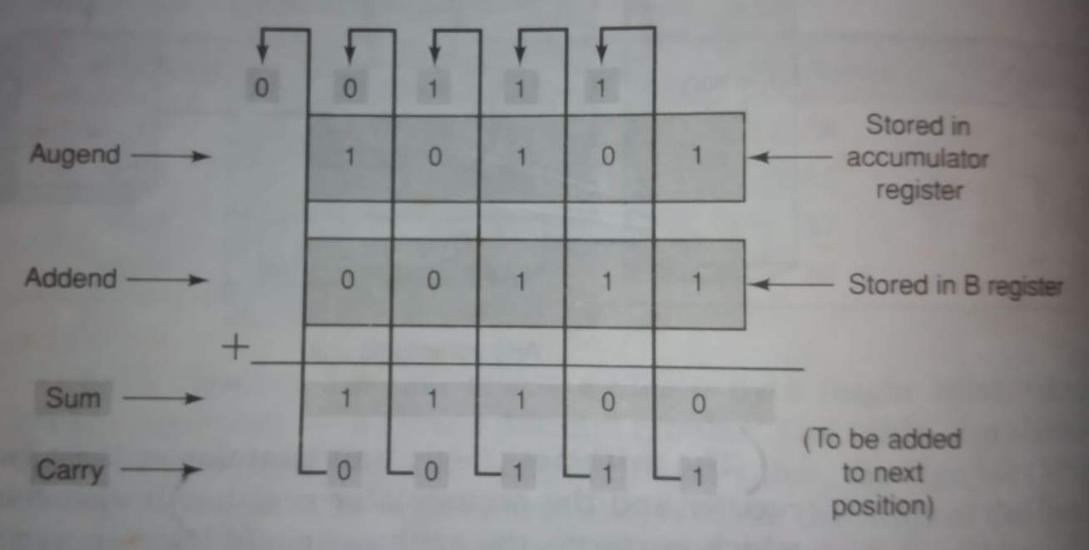
Parallel binary adder

Slide 7
Parallel binary adder
The arrangement of the following figure is called a parallel adder because all of the bits of the augend and addend are present and are fed into the adder circuits simultaneously.
A full adder circuit has three inputs (A, B, C_{in}) and two outputs (sum and carry).

Slide 8
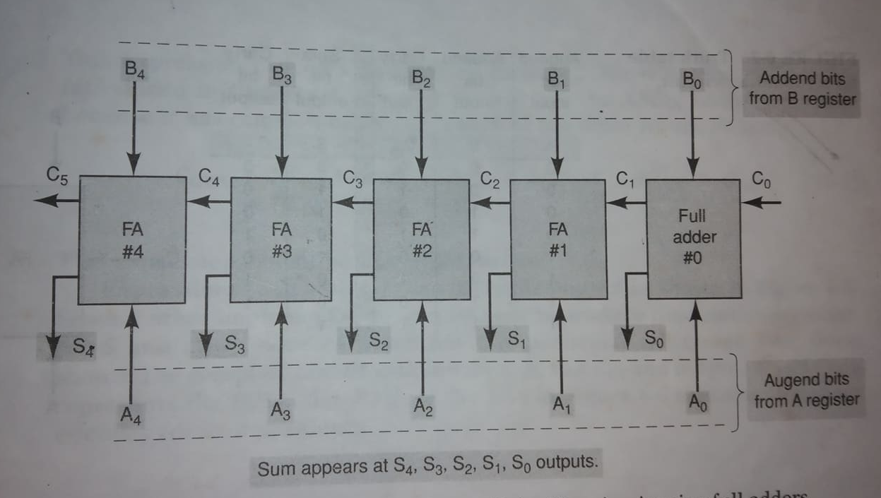
Parallel binary adder

Slide 9
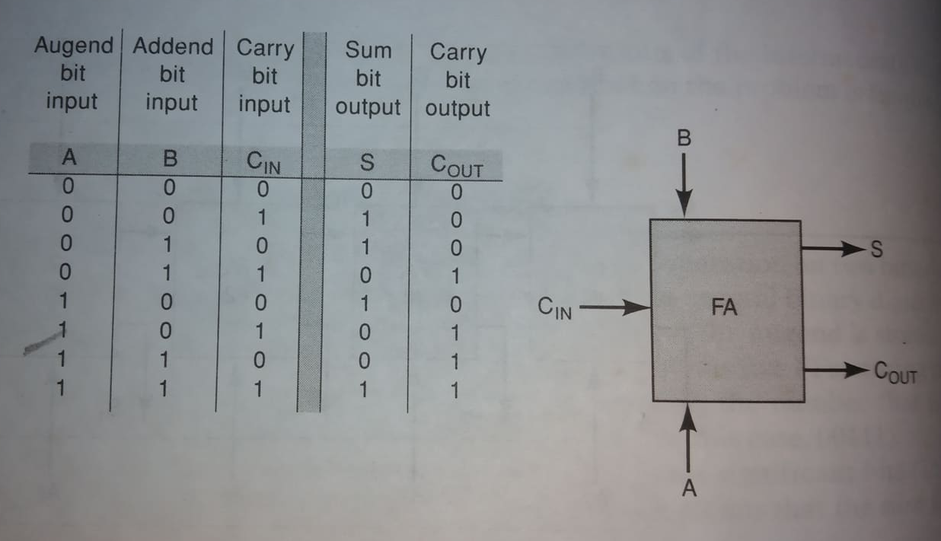
Design of a full adder (Truth table)

Slide 10
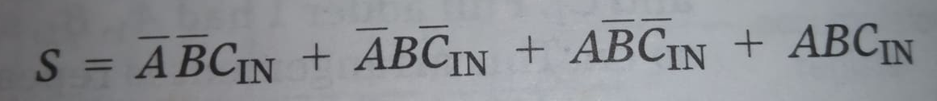
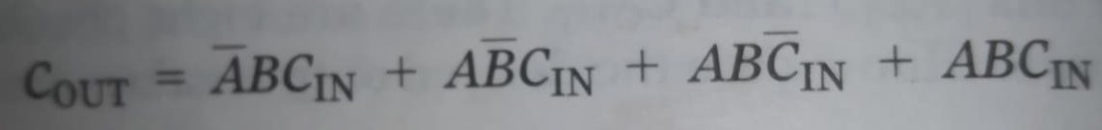
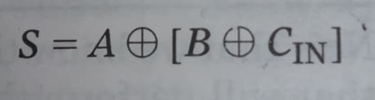
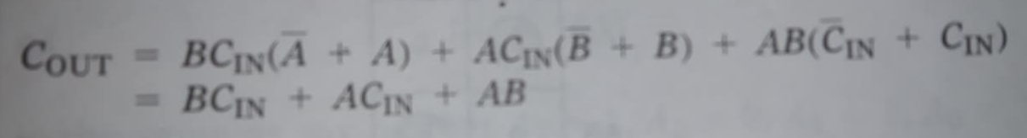
Design of a full adder (sop expression) Home work

Slide 11
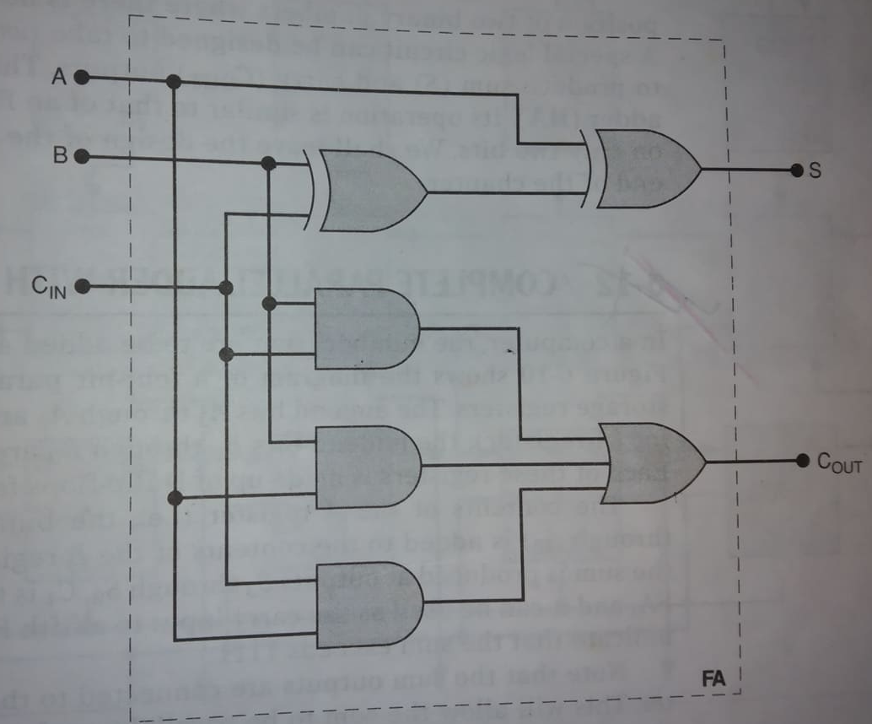
Design of a full adder

Slide 12
Half adder (home work)

Slide 13
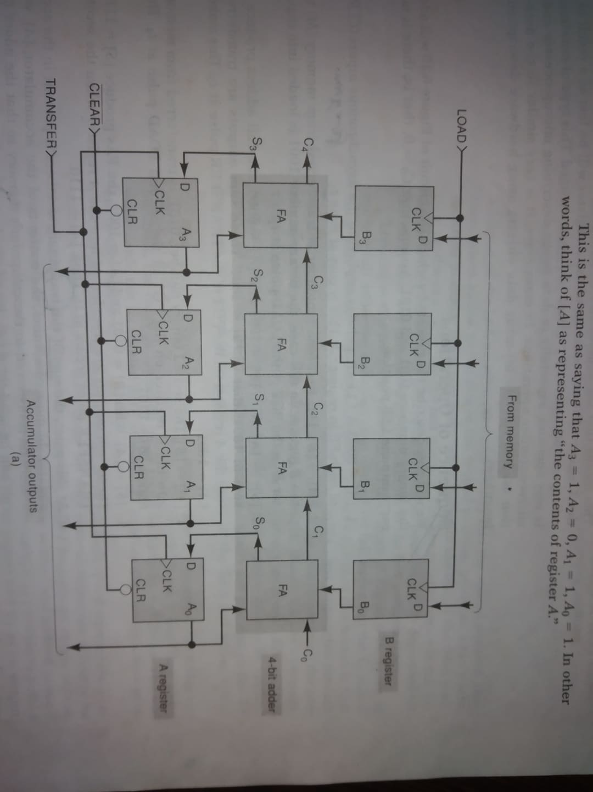
Parallel adder with registers

Slide 14
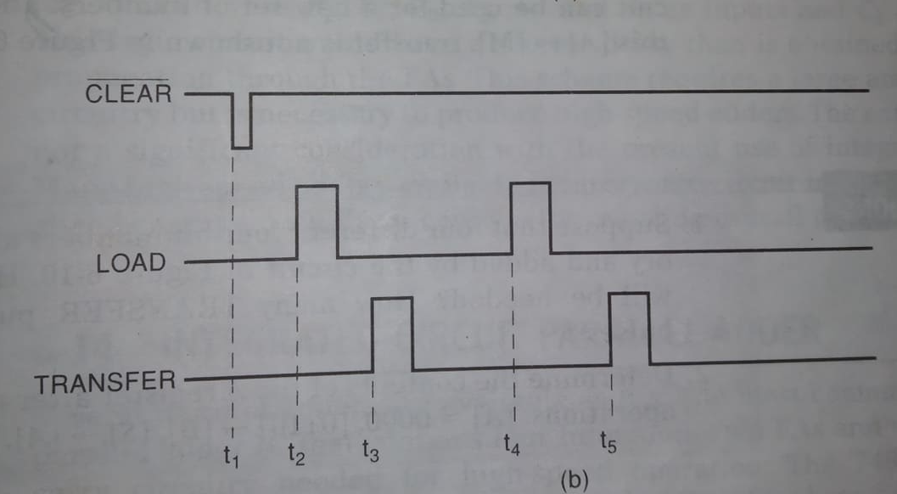
Parallel adder with registers

Slide 15
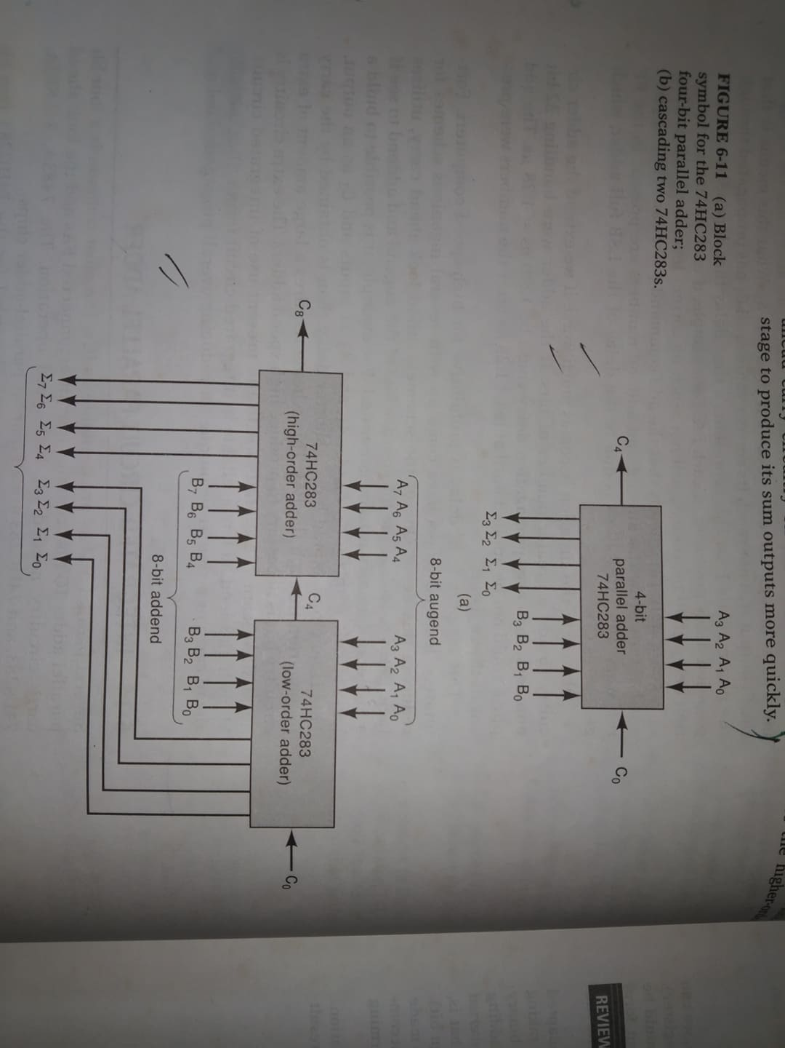
4 bit Parallel adder IC 74hc283

Slide 16
Cascading two 74hc283 IC

Slide 17
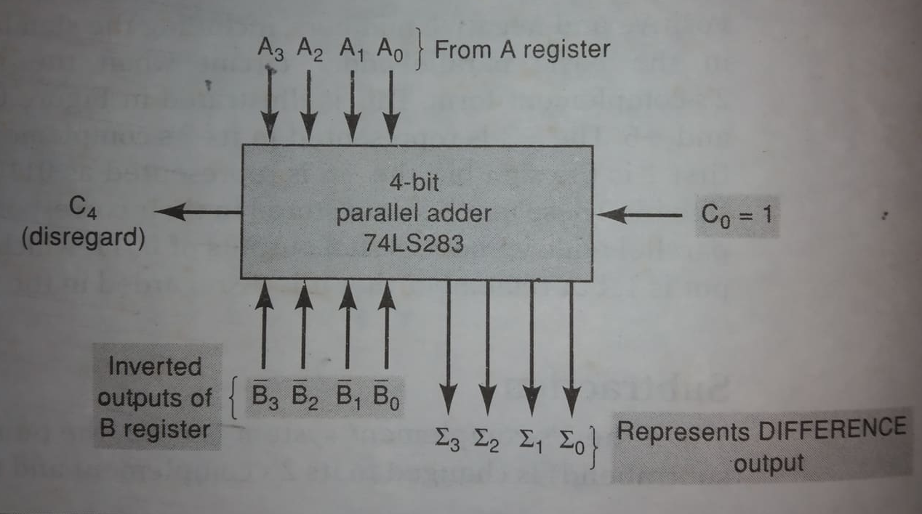
2’s complement addition subtraction using 74ls283 IC

Slide 18
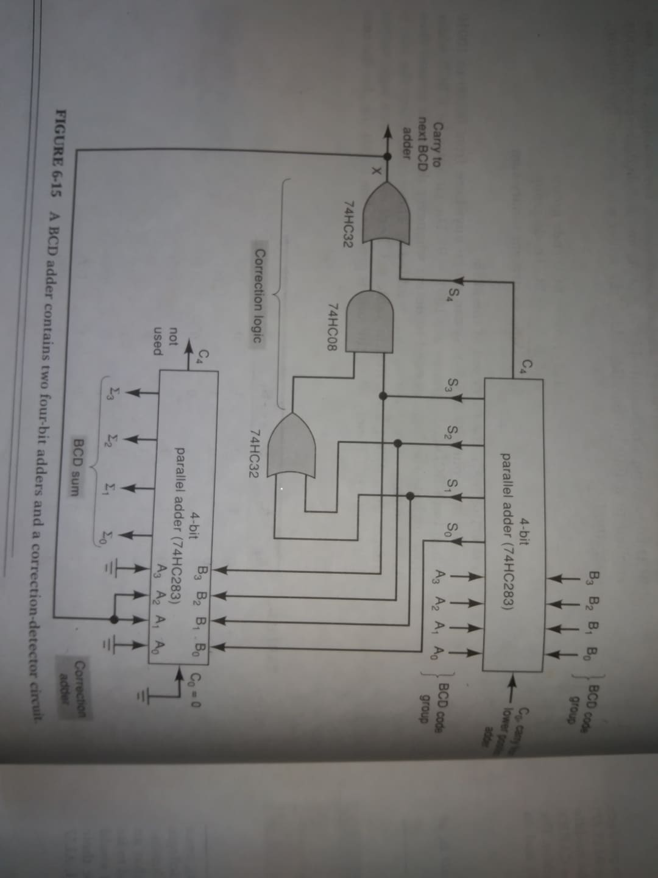
BCD adder using 74hc283
1
0
1
0
1
1
1
1

Slide 19
Counter and registers

Slide 20

Mod (modulus) number
MOD number indicates, the number of states in the counting sequence. For a 3 bit binary counter, MOB number is $2^{3}=8$ (MOD-8), counting 000 to 111, after the 8th clock pulse it returns to 000 and so on. For a 4 bit binary counter, MOB number is $2^{4}=16$ (MOD-16), counting 0000 to 1111, after the 16th clock pulse it returns to 0000 and so on.
MOD-8 counter requires 3 FF, MOD-16 requires 4 FF, MOD $2^{N}$ requires N FF
(counting up $2^{N}$-1). Each FF divides the frequency of its input by 2. If N is the last FF, the output frequency from it is equal to $\frac{1}{2^{N}}$ of the input frequency.

Slide 21
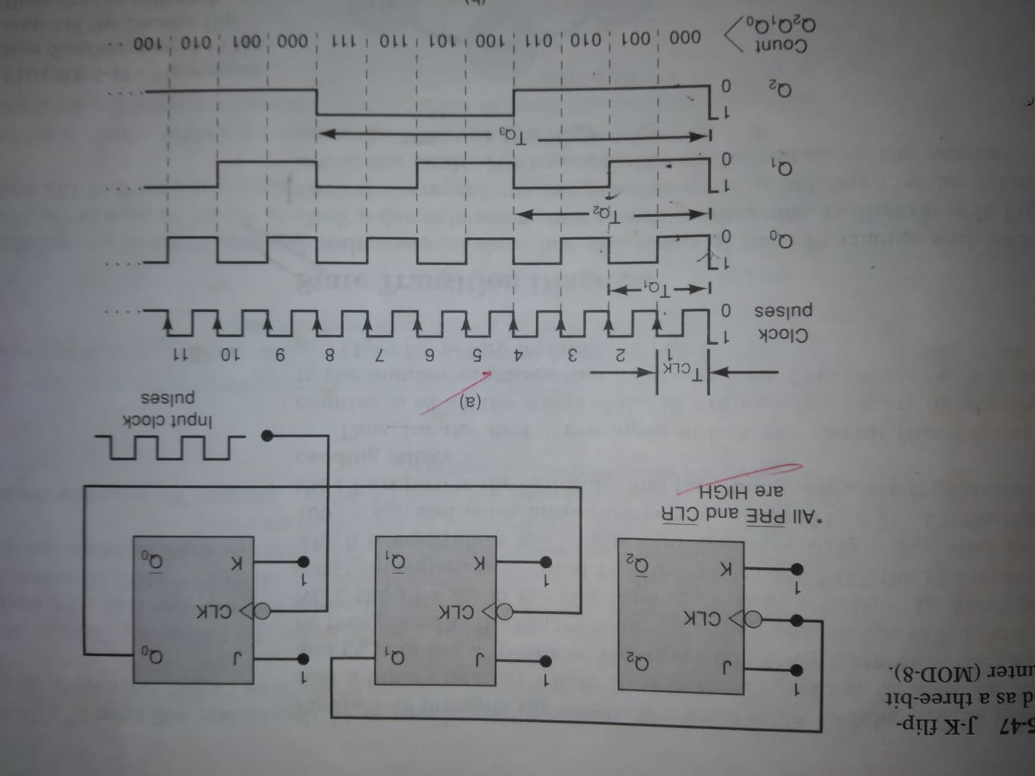
Frequency division and counting: RECAP

Slide 22
Asynchronous ripple Counter

Slide 23
Asynchronous ripple Counter
This type of counter is referred to as a ripple counter because of the way the FFs respond one after another in a kind of rippling effect.

Slide 24
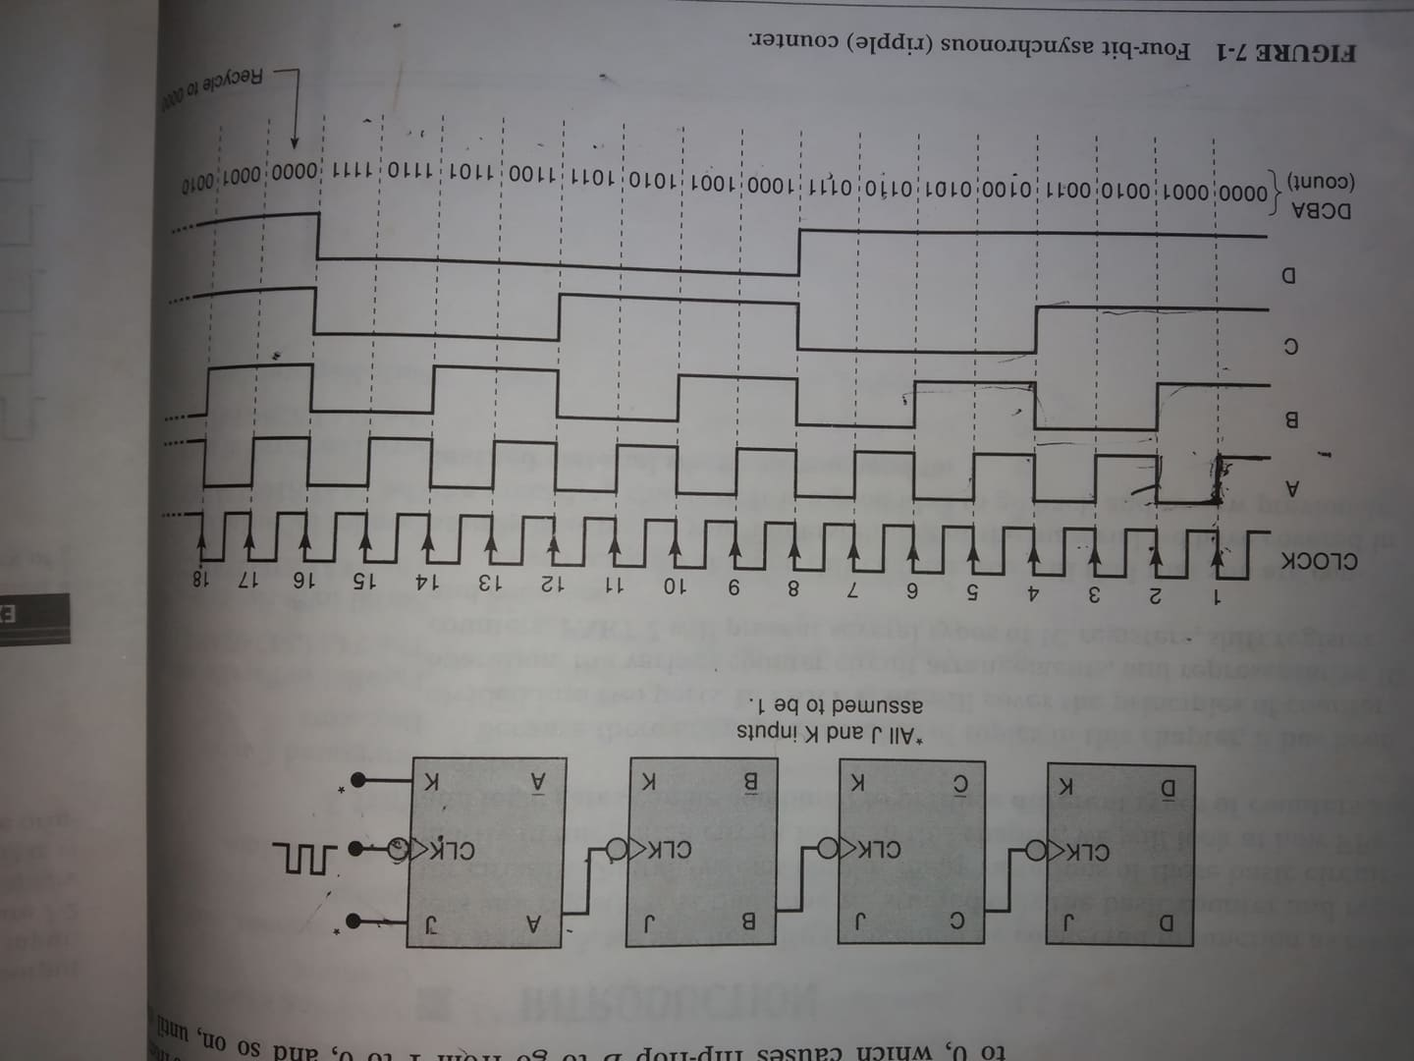
Asynchronous ripple Counter

Slide 25
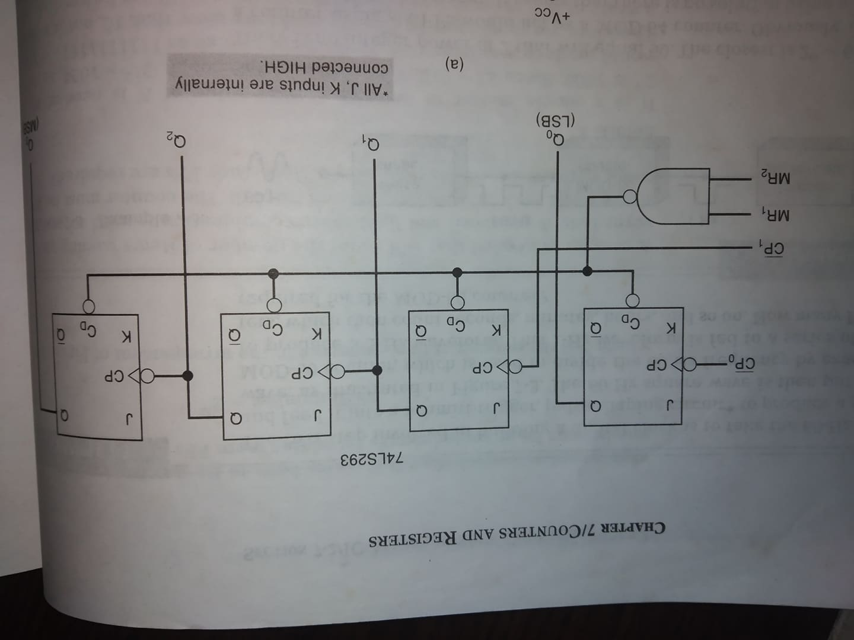
IC Asynchronous Counter

Slide 26
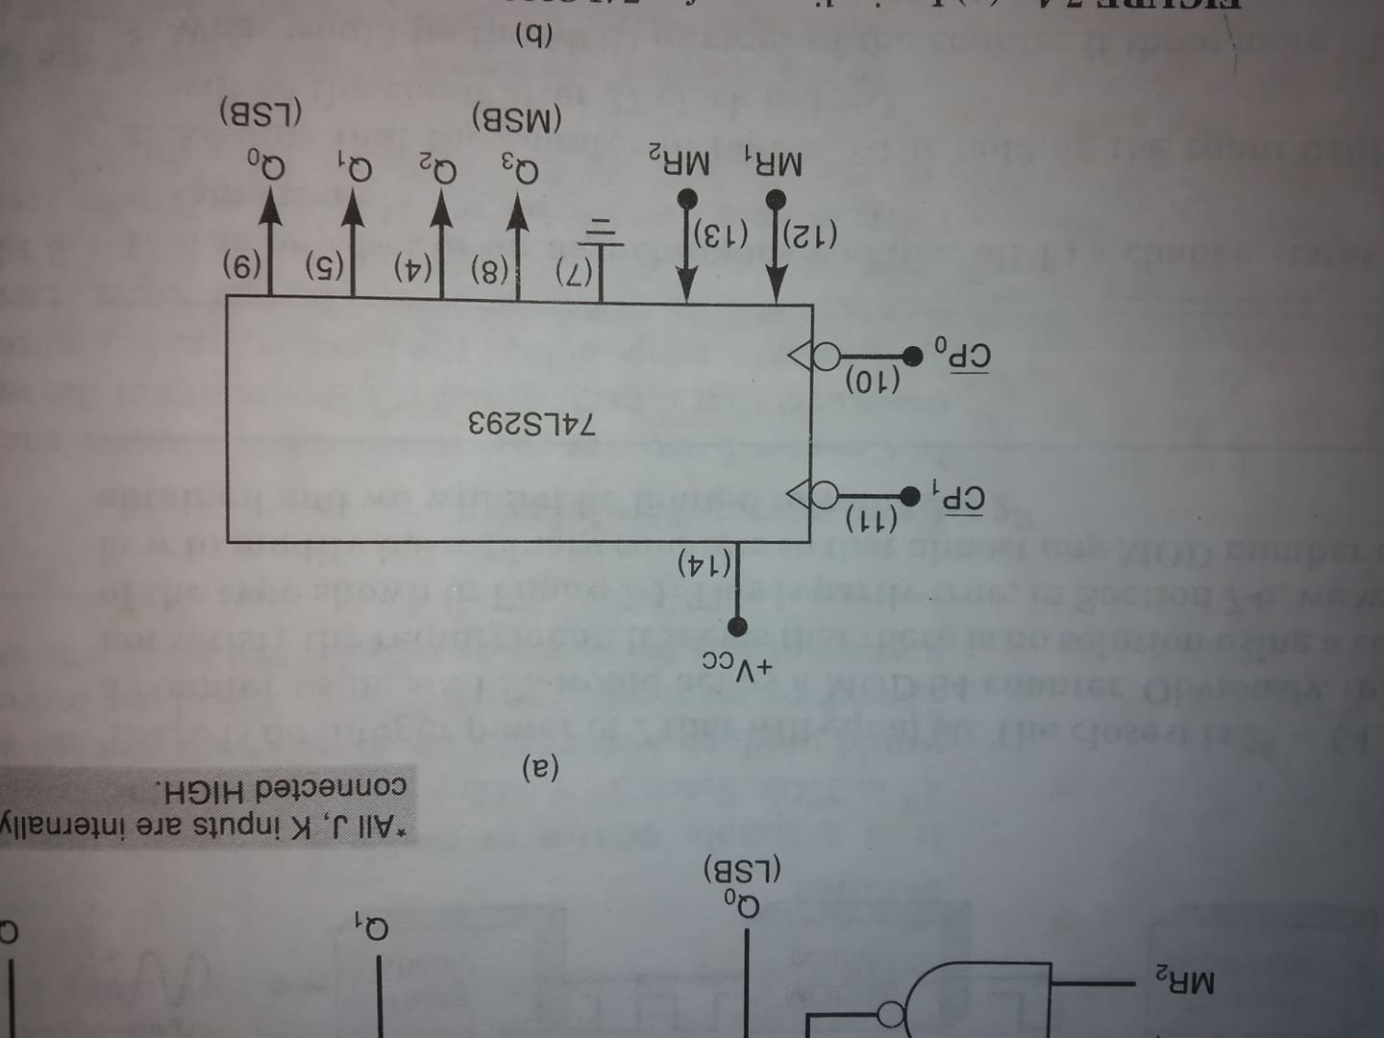
IC Asynchronous Counter

Slide 27
Construct a MOD-10/ 16 counter using 74ls293 ic

Slide 28
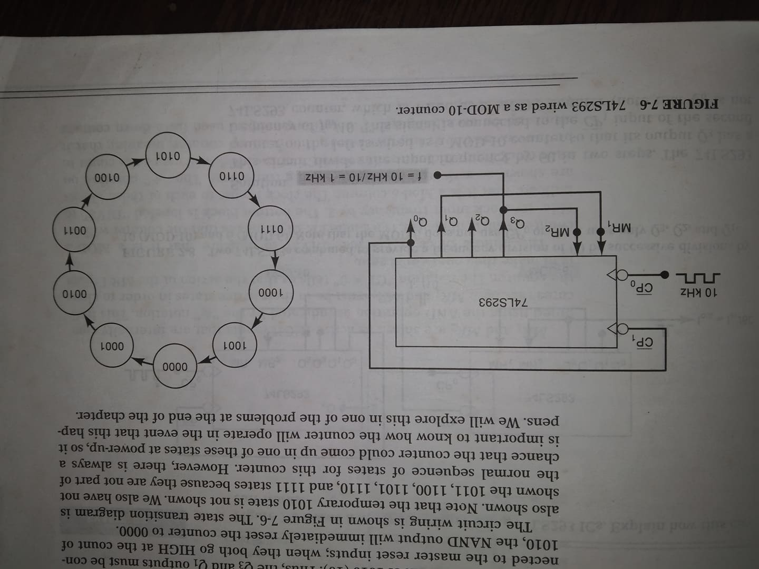
Construct a MOD-10 counter using 74ls293 ic

Slide 29
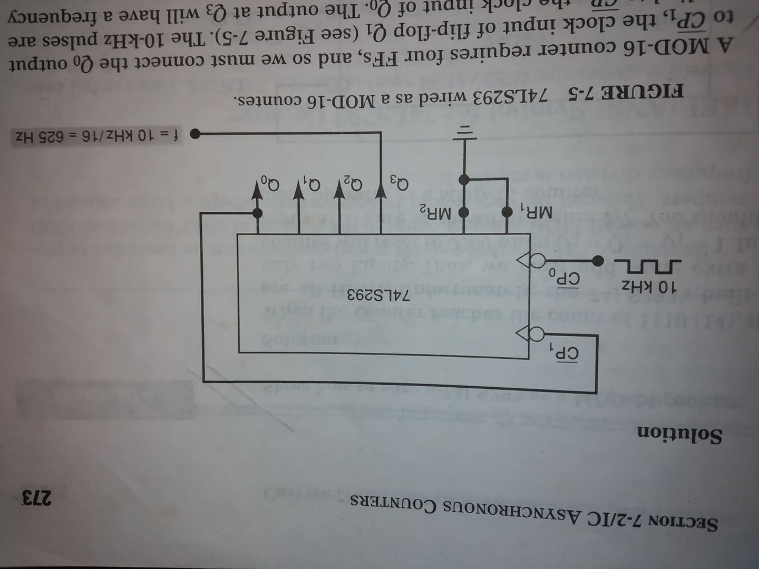
Construct a MOD-16 counter using 74ls293 ic

